Slide 1

Overview of VAdata
Virginia’s Sexual and Domestic Violence Data Collection System

Slide 2
Tell me about VAdata
The concept of an electronic data collection system for sexual and domestic violence agencies (SDVAs) in Virginia was first introduced in 1996.
The Action Alliance (then Virginians Against Domestic Violence) was given one of the first VSTOP grant awards to create the system.

Slide 3
Fun Fact
When VAdata was first envisioned in 1996, there were no sexual or domestic violence agencies using the internet as a resource or using email as a routine method of communication.

Slide 4
How was VAdata Created?
The complete data collection system was created over a period of 3 years. There were MANY, MANY people involved, including:
  Virginians Aligned Against Sexual Assault
  Department of Social Services
  Department of Health
  Department of Criminal Justice Services
  Department of Housing
  Advocates and Directors in sexual and domestic violence agencies

Slide 5
When did VAdata go live?
The full VAdata system went live on October 1, 1999.
VAdata has produced annual reports each year since 2000.

Slide 6
What has changed over the years?
Until 2008, the actual data collected changed very little. The software that runs VAdata, however, has changed to accommodate growing trends and needs in the field.
The VAdata programmers (located in Northern Virginia) have made it possible for VAdata to grow with the times through frequent software upgrades.

Slide 7
What happened in 2008?
The changes that happened in 2008 were a result of a full evaluation of VAdata that began in 2005.
Focus groups were conducted throughout the state to determine what was working well with VAdata and what could be improved.
As a result of the evaluation, VAdata was streamlined so that less data and more valid data were collected.

Slide 8
Fun Fact
VAdata is the only electronic data collection system in the United States that collects data about BOTH sexual and domestic violence and is fully supported by a DV/SA advocacy agency.

Slide 9
VAdata Pride
From the very beginning, confidentiality of victims has been a primary goal of statewide data collection. Identifying data has never been included in the VAdata system.
This served Virginia well when, in 2006, the federal Violence Against Women Act prohibited the collection of identifying data in electronic systems.

Slide 10
How is VAdata used?
VAdata is the only data source in Virginia that describes the experiences of victims of sexual and domestic violence and the services that were provided to them by sexual and domestic violence agencies.
The data are provided through several different reports.

Slide 11
What information is collected?
There are 4 primary areas of data collection in VAdata:
  Advocacy: This is information collected about every person who receives face-to-face services.
  Hotline: This is information collected about every hotline call.
  Community Engagement Activities: This documents information on activities, such as public awareness, educational programming, training, and community collaborations
  Prevention – this tracks agency-based primary prevention strategies and programs

Slide 12
What reports does VAdata Generate?
Reports for Funders:
  The VDSS report describes domestic violence agency services and the victims those agencies serve.
  The VDSS Outcomes report provides a provides a summary of selected data from the Documenting our Work surveys and from the Community Engagement form.
  The DCJS - VSGP report describes sexual and domestic violence and human trafficking services and the victims those agencies serve.
  The VSTOP and Victim Fund (VFUND) reports compile data on the victim services and training events funded by VSTOP and/or Victim Fund grants.
  The Housing Stabilization reports are general reports published for the Virginia Department of Housing and Community Development (DHCD), Housing and Urban Development (HUD, a federal program), and Emergency Services Grant program (also a federal program, often administered by cities). The HMIS CAPER and APR report are available to HMIS-enabled agencies.

Slide 13
What reports does VAdata Generate?
Reports for SDVAs:
The Advocacy Data report provides comprehensive aggregated data from everything entered via the advocacy form.
The Community Engagement report provides an overview of all community engagement activities, such as public awareness, educational programming, training, and community collaboration.
The DOW reports (Community Services and Shelter) provide a summary of the feedback offered by survivors who completed the Documenting Our Work surveys.
The Local Agency reports (DV, SV, and Dual) provide an overview of all advocacy data separated by SV survivors, DV survivors, and a deduplicated count of those who’ve experienced both SV and DV.

Slide 14
What reports does VAdata Generate?
More Reports for SDVAs:
The Hotline Data report provides a comprehensive aggregated from all the data entered via the hotline form.
The Sexual Assault Services report provides an overview of all sexual assault services provided to survivors by your agency formatted similarly to the VDSS report.
The Summary Report by Staff provides a brief summary of services and hours of service provided by each staff to survivors.
The Report by Participant Code report details the services provided to one individual over a period of time.
The Local Prevention Report details the number, locations, and types of prevention strategies an agency has either in progress or completed

Slide 15
What reports does VAdata Generate?
Statewide Reports:
VAdata produces 3 aggregate statewide reports for the general public
  Sexual violence services
  Domestic violence services
  Prevention strategies

Slide 16
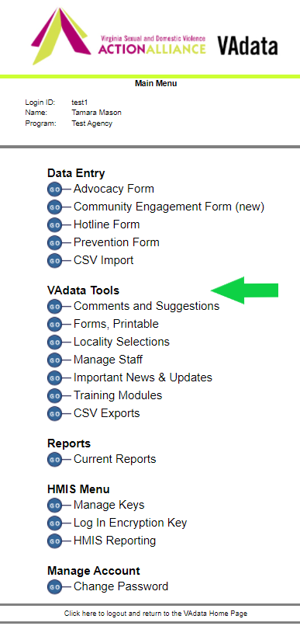
What else is on the VAdata site?
There are a number of Tools on the VAdata Main Menu:
  Comments and Suggestions
  Forms, Printable
  Locality Selections
  Manage Staff
  Important News & Updates
  Training Modules
  CSV Exports

Slide 17
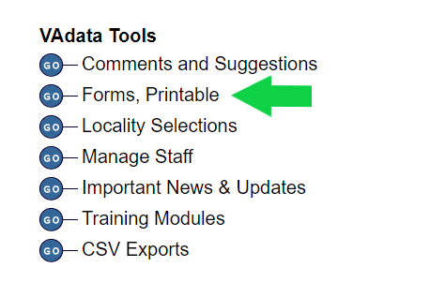
Forms, Printable
Here you can find Microsoft Word© versions of the Hotline, Advocacy, Community Engagement (including VSTOP and Victim Fund supplements), and Prevention forms. If you download these files, you can print them. You can also edit these forms to suit your local agency needs. The required VAdata fields are indicated.
You will also find .pdf versions of the Documenting Our Work Shelter and Community-Based
Services Surveys in multiple
languages. The files here are
pre-populated with your agency
name and identification number.
Please use these files to make
copies of the surveys.

Slide 18
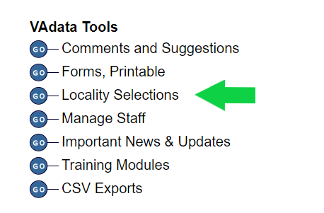
Locality Selections
One of data fields on the Hotline and Advocacy forms is the “locality” of the person receiving services.
On this page, you can select up to 15 localities that will then appear on your Hotline and Advocacy electronic forms as a short drop-down list.
Many users find that creating the short list is more user-friendly than viewing the full list of over 150 Virginia localities.

Slide 19
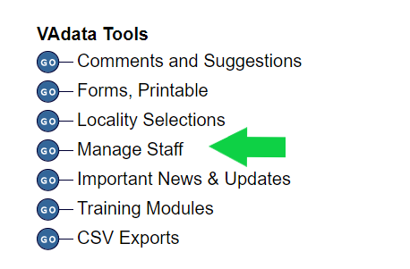
Manage Staff
Here you can add new staff or deactivate staff who have left the agency. Only your “active” staff list will appear in the drop-down lists of VAdata forms.
It is important to “deactivate” staff rather than delete names from the list, as those names are attached to records of the survivors they served.

Slide 20

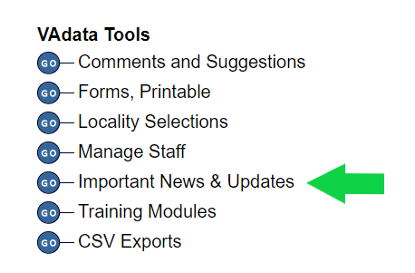
Important News & Updates Screen
Here, you can view the important updates and info, the first screen that opens after logging in to VAdata.
VAdata staff use this screen to provide important VAdata information, so please check it regularly.

Slide 21
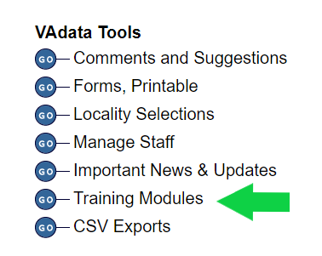
Training Modules
Here you will find several PowerPoint presentations covering various VAdata topics. These training modules are useful for training new staff and for providing more detailed information to all staff.
We recommend that all staff take time to review each training module!

Slide 22
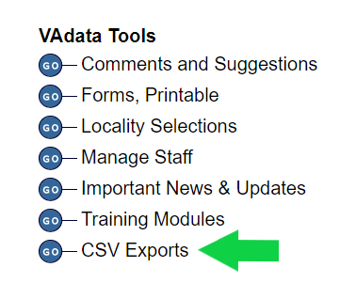
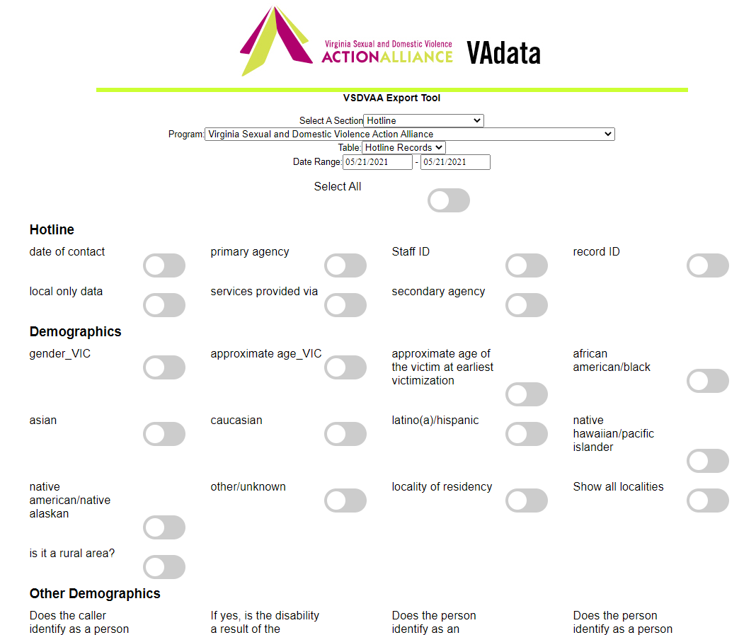
CSV Exports
Here you can select data to export from VAdata into a simple CSV (comma-separated values) file to move record-level data into another system or to do external analysis. You can download data from the Hotline, Advocacy, and Community Engagement forms.

Slide 23

Help Options
You may note this symbol by several fields on the form:
Click on the symbol for more detailed information or requirements of the field.

Slide 24
HELP! VAdata’s not working.
If you think something is wrong with VAdata, please let us know! Give us a call at 804.377.0335 OR email us at vadataadmin@vsdvalliance.org.
We don’t use VAdata in the same ways you do, so sometimes the only way that we know something is off or broken is when you tell us.
We also like to talk with you by phone when you have questions, because we usually want information that you might not know we need.

Slide 25
How Can I Get Additional Help About Other Topics or Concerns?
The Action Alliance staff urge you to contact us whenever you have a question or a concern about VAdata, resources, advocacy, policy, training, funding, or anything else.
Staff can be reached at
804.377.0335
Or you can visit our website to send a message directly to staff members. Visit https://vsdvalliance.org/contact/.

